Slide 1
Virtual Box
Performed by student
group RPZ-13a
Kateryna Hranat

Slide 2
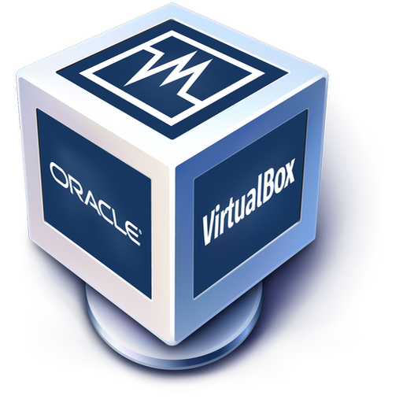
What is this?
VirtualBox is a free and open-source virtualization program developed by Oracle. It allows you to create and manage virtual machines on various operating systems such as Windows, macOS, Linux, and others.

Slide 3
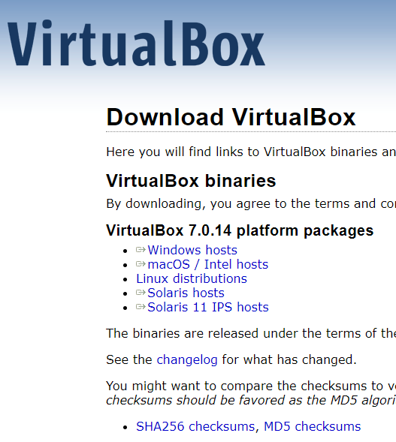
Downloading
Go to this website: https://www.virtualbox.org/wiki/Downloads.
Choose the version suitable for your operating system; in my case, for Windows.
Download it.

Slide 4
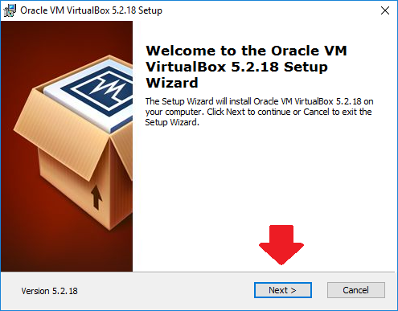
INSTALLING
Open downloaded file
Follow the instructions

Slide 5
Creating a new virtual machine
Creating a new virtual machine: Click the “Machine" button in the top-left corner of the VirtualBox window. This will start the new virtual machine creation wizard.
Configuring virtual machine parameters: You will be prompted to enter a name and choose the type of operating system you will be installing. Select the type and version of the OS you plan to install on the virtual machine.
Setting the amount of memory: Choose the amount of memory (RAM) you want to allocate to the virtual machine. It's important to consider the available RAM on your computer to avoid exceeding the limit.
Creating a virtual hard disk: Select the option "Create a virtual hard disk now" and click "Next". Choose the disk type (usually recommended to use VDI format) and select the storage type (usually recommended to use dynamically allocated). Specify the disk size and click "Create".

Slide 6
Configuring virtual hard disk parameters: Select the size and location to save the virtual hard disk. Click "Create".
Completing the new virtual machine creation wizard: Once the wizard is complete, you will see the new virtual machine in the list of virtual machines in the main VirtualBox window.
Configuring additional parameters (optional): You can configure additional virtual machine parameters such as network settings, sound, USB, etc., by right-clicking on the virtual machine and selecting "Settings".
Installing the operating system: After creating the virtual machine, you can install the operating system by starting the virtual machine and booting the OS image through the virtual optical drive or another installation method.

Slide 7
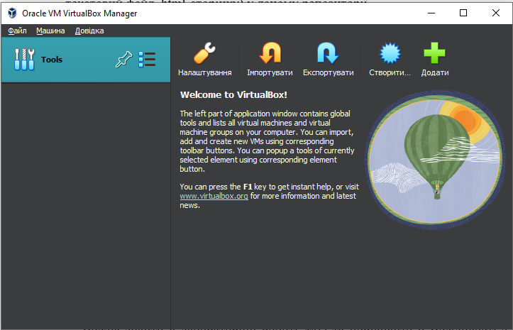
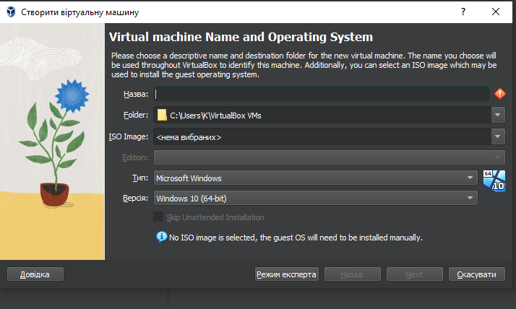
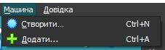




Slide 8
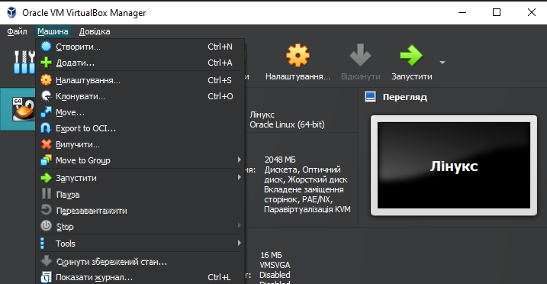
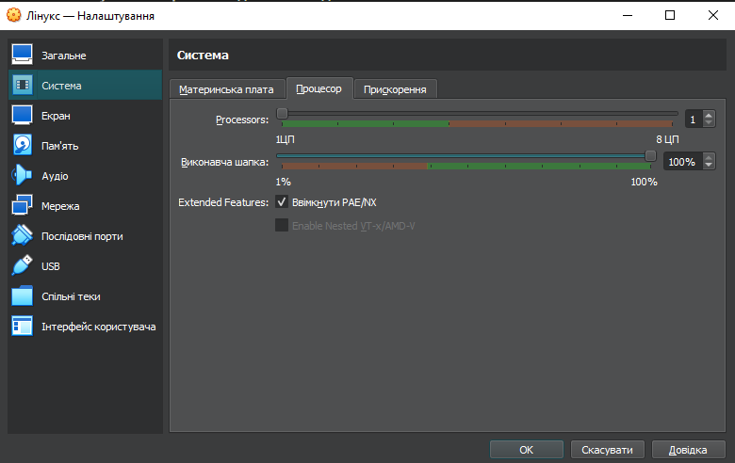
Adding hardware:
Launch VirtualBox and open the virtual machine to which you want to add hardware.
From the main menu, select "Machine" and then choose "Settings".
In the settings window, select "Processor" or "System".
Here, you can change the number of CPU cores, amount of RAM, and other hardware parameters.

Slide 9
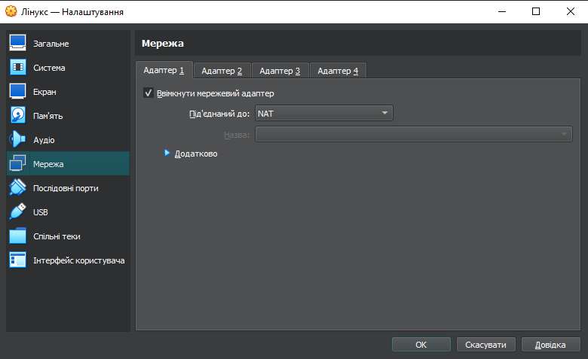
Configuring network
In the settings window, select "Network".
Choose the type of network you want to configure (e.g., NAT, bridged, or internal network).
To connect the virtual machine to a Wi-Fi access point, select the "Bridged" network type and choose your Wi-Fi card as the network adapter.

Slide 10
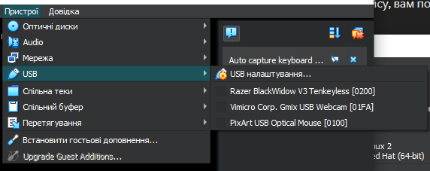
Working with external drives (USB flash drives):
Insert the external drive (e.g., USB flash drive) into your computer.
In the main VirtualBox window, select the virtual machine to which you want to connect the external drive.
From the main menu, choose "Devices" → "USB" → [name of your USB device].

Slide 11
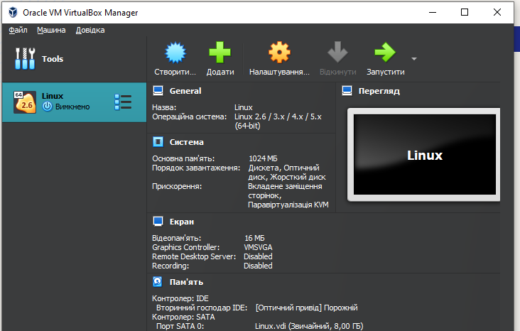
Creating virtual machine linux

Slide 12
creating a second virtual machine
Unfortunately, I am unable to boot CentOS and complete the other steps, but I can explain how to do it.
Install the GNU/Linux CentOS operating system in minimal configuration with terminal input-output without a graphical interface:
Download the CentOS image from the website https://www.centos.org/.
Create a virtual machine in VirtualBox. Open VirtualBox and click the "New" button.
Enter the name of your virtual machine, choose the type "Linux," and version "Red Hat (64-bit)."
In the "Memory" window, select the minimum amount of RAM required for installing CentOS. In the "Hard disk" window, select "Create a virtual hard disk now" and choose the disk type and size you need.
Configure the virtual machine. Select the virtual machine from the list and click "Settings." In the settings window, go to "Storage" and select the ISO image you downloaded earlier in step 1.

Slide 13
Start the virtual machine:
After configuring the virtual machine, click "Start" to launch it. Select the option "Install CentOS" or “Download CentOS" and press Enter.
Follow the installation steps:
Follow the instructions of the CentOS installer, which will be working in the terminal. Install the minimal set of components you need, including capabilities for terminal input-output.
Completion of the installation: After the installation is complete, reboot the virtual machine.
You can log in to the CentOS system using the credentials you set during the installation and start working in the terminal environment.
2. To install the GNOME graphical desktop environment on CentOS, you can follow these steps:
First, make sure your CentOS system is up-to-date by running the following commands in the terminal:
sudo yum update
Next, install the GNOME desktop environment by running:
sudo yum groupinstall "Server with GUI"
Once the installation is complete, you may need to set the default target to graphical mode. You can do this by running:
sudo systemctl set-default graphical.target

Slide 14
Reboot your system for the changes to take effect:
sudo reboot
After rebooting, CentOS should boot into the GNOME graphical desktop environment.
3. To install an additional graphical desktop environment alongside GNOME on CentOS and compare their capabilities, you can follow these steps:
Install the Additional Desktop Environment:
You have several options for alternative desktop environments. One popular choice is KDE Plasma. To install KDE Plasma, run the following command in the terminal:
sudo yum groupinstall "KDE Plasma Workspaces"
Switch to the KDE Plasma Desktop:
After the installation is complete, log out of the GNOME desktop environment. On the login screen, click on the gear icon or the session type option to select the KDE Plasma desktop environment.
Compare Features:
Once logged in, explore the KDE Plasma desktop environment and compare its features with GNOME. Pay attention to the layout, customization options, bundled applications, performance, and overall user experience.

Slide 15
Optional: Uninstall the Additional Desktop Environment:
If you no longer need the additional desktop environment, you can uninstall it by running:
sudo yum groupremove "KDE Plasma Workspaces"
Brief comparison between the GNOME and KDE Plasma desktop environments:
GNOME:
User Interface: GNOME has a clean and minimalist interface with a focus on simplicity and usability. It uses a single panel at the top for accessing applications, system settings, and notifications.
Default Applications: GNOME comes with a set of default applications, including Files (Nautilus) for file management, GNOME Terminal for the terminal emulator, and GNOME Software for software management.
Customization: GNOME offers limited customization options compared to KDE Plasma. Users can customize the desktop background, themes, and extensions through the GNOME Tweaks tool.
Performance: GNOME tends to be more resource-intensive compared to some other desktop environments, which may impact performance on older hardware.

Slide 16
KDE Plasma:
User Interface: KDE Plasma provides a more traditional desktop layout with a panel at the bottom containing an application launcher, task manager, system tray, and clock. It offers a highly customizable interface with various desktop widgets (Plasmoids).
Default Applications: KDE Plasma includes a wide range of default applications, such as Dolphin for file management, Konsole for the terminal emulator, and Discover for software management. It also offers a suite of KDE applications like KDE Connect and Kontact.
Customization: KDE Plasma is known for its extensive customization options. Users can personalize almost every aspect of the desktop environment, including themes, widgets, and keyboard shortcuts, through the System Settings application.
Performance: While KDE Plasma offers rich features and customization options, it tends to be more resource-efficient compared to GNOME, making it suitable for a wider range of hardware configurations.

Slide 17

Conclusions:
During the execution of this Work Case, I have improved my skills in working with virtual machines, configuring them, and acquired more interesting information. I have applied my knowledge in practice.
Author – Kateryna Hranat

Slide 18
Thank you for attention!

